Slide 1

4.

Slide 2
Agenda
Test design techniques. EP and BVA.
Test Design Techniques lvl2. State Transition and others.
Specification. What is it?
Specification Types. User Story. Acceptance Criteria.
Practice “Adventure Park”.
Project Documentation.
Agile Documentation
DOD
DOR
Grooming session. Goals. Estimation.

Slide 3
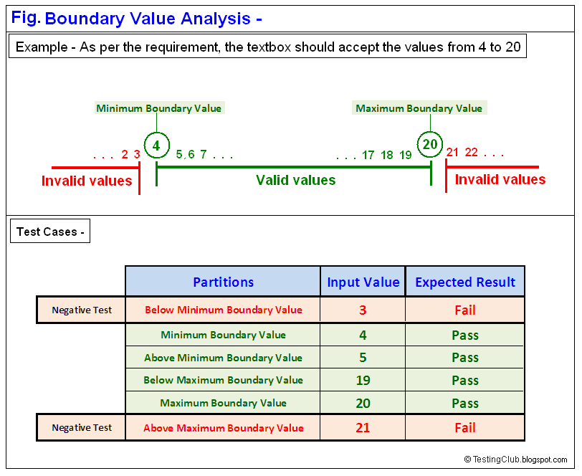
BVA and EP. Test design techniques.

Slide 4
Reminder: Test design techniques
Static
Dynamic
testing of a component or system at specification or implementation level without execution of that software, e.g. reviews or static code analysis
testing that involves the execution of the software of a component or system
structure-based
specification-based
experience-based
Notes:
Reminder from the 2nd lecture:
1. Structure-based: Unit testing, integration testing
2. Specification-based: based on requirements documentation
3. Experience-based: no documentation, just exploratory

Slide 5
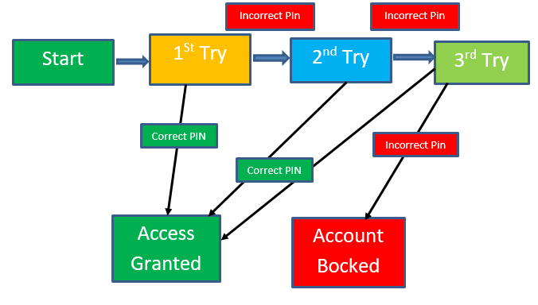
Test design techniques lvl2 (Spec based.)
State Transition Diagrams:
State Transition testing is defined as the software testing technique in which changes in input conditions cause's state changes in the Application under Test (AUT).
It is a black box testing technique in which the tester analyzes the behavior of an application under test for different input conditions in a sequence. In this technique, tester provides both positive and negative input test values and record the system behavior.
Example: Let's consider an ATM system function where if the user enters the invalid password three times the account will be locked.
Notes:
Техники тест-дизайна 1-го уровня достаточно просты и понятны. Я думаю, вы скажете, да это легко, но зачем досконально проверять каждый элемент. И будете правы!.. Чаще всего их применяют при разработке нового ПО, потому что единожды после проверки элементов системы при разработке они в дальнейшем не часто подлежат изменению на уровне работы элемента. Не нужно постоянно проверять каждое значение элемента в каждом экране вашей программы, но имейте ввиду, что если изменяется логика обработки данных в элементах программы, необходимо повторно убедиться в правильности обработки значений элемента. Техники тест-дизайна 2-го уровня отвечают за вариативность и комбинаторику данных при проверке ПО.
Помимо “State Transition Diagram” Еще бывают –
Specification based (Black Box):
Decision Table (матрица принятия решений или таблица причин следствий)
Decision Table is aka Cause-Effect Table. This test technique is appropriate for functionalities which has logical relationships between inputs (if-else logic). In Decision table technique, we deal with combinations of inputs. To identify the test cases with decision table, we consider conditions and actions. We take conditions as inputs and actions as outputs.
Таблицы решений являются хорошим способом описания требований, когда существует несколько бизнес-правил, взаимодействующих друг с другом. Используя данный метод, специалисту становится проще написать требования, которые включают все доступные условия. Применение этой техники помогает лучше проанализировать тестируемый продукт, систематизировать все знания по нему. В итоге становится легче писать полные тестовые примеры, охватить все возможные комбинации.
PairWise testing:
https://www.softwaretestinghelp.com/what-is-pairwise-testing/
ISTQB defines All-Pairs Testing (or Pairwise Testing) as A black-box test design technique in which test cases are designed to execute all possible discrete combinations of each pair of input parameters.
The output of a software application depends on many factors e.g. input parameters, state variables and environment configurations. Techniques like boundary value analysis and equivalence partitioning can be useful to identify the possible values for individual factors. But it is impractical to test all possible combinations of values for all those factors.
So instead a subset of combinations is generated to satisfy all factors.
Сформулировать суть попарного тестирования можно следующим образом: формирование таких наборов данных, в которых каждое тестируемое значение каждого из проверяемых параметров хотя бы единожды сочетается с каждым тестируемым значением всех остальных проверяемых параметров.
Experience based:
Exploratory
Error guessing
Fault Attack
Structure based (White BOX)
The exact opposite of the black box test design technique, white box test design technique necessitates knowledge of the internal structure of a program. Some of the methods implemented in this type of technique are:
Decision table
Condition
Statement

Slide 6
Agenda
Test design techniques. EP and BVA.
Test Design Techniques lvl2. State Transition and others.
Specification. What is it?
Specification Types. User Story. Acceptance Criteria.
Practice “Adventure Park”.
Project Documentation.
Agile Documentation
DOD
DOR
Grooming session. Goals. Estimation.

Slide 7

What is specification?
The software requirements specification (SRS) lays out functional and non-functional requirements, and it may include a set of use cases that describe user interactions that the software must provide.
Notes:
Общее пояснение требований, для чего, кем пишется, кратко - структура
Виды: Документация, Дизайны, Гайдлайны, Юзергайды, Юзер Стори, Технические диаграммы, Модели данных, Стори и Таски.
Флоу обработки документации. От Идеи до Саб-Таски.

Slide 8
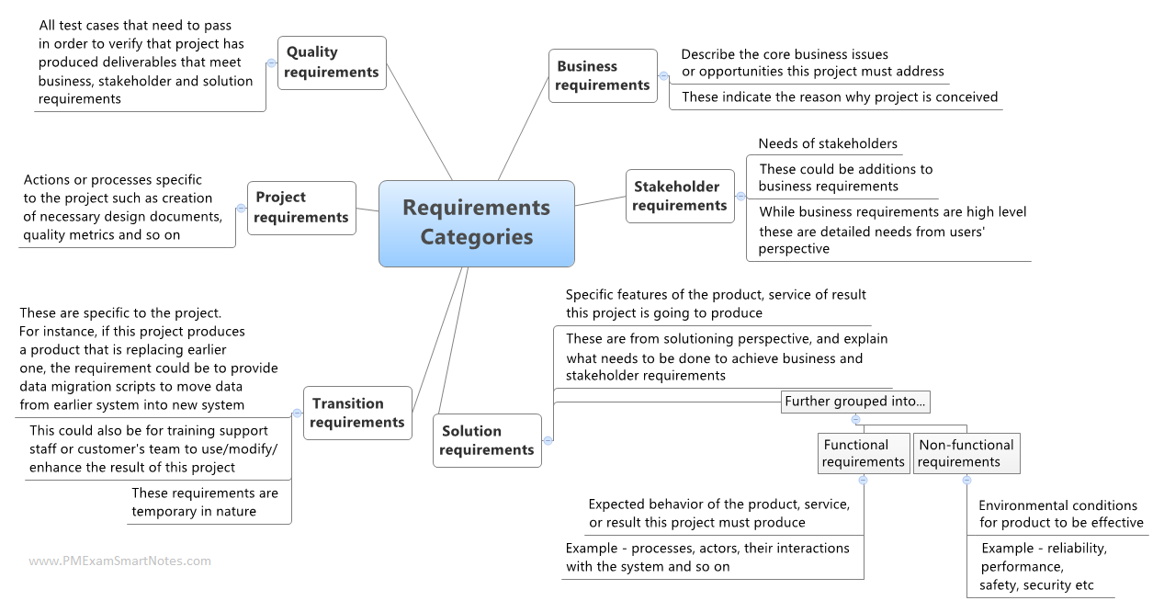

Slide 9
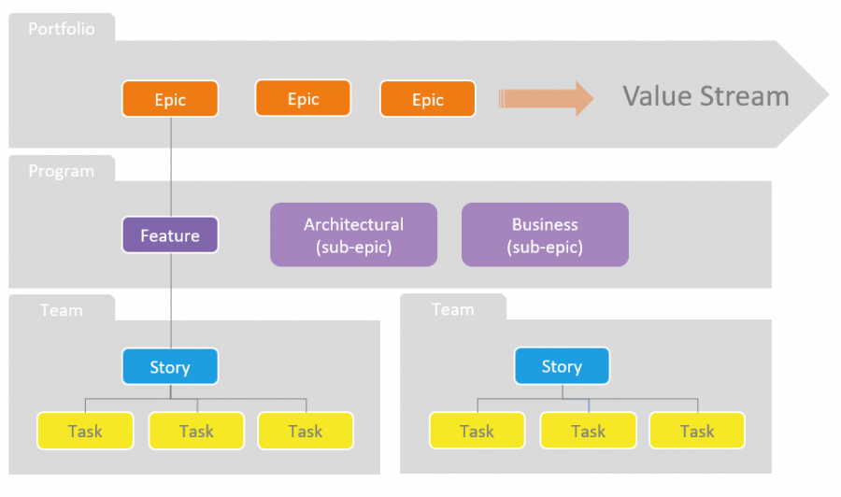

Slide 10
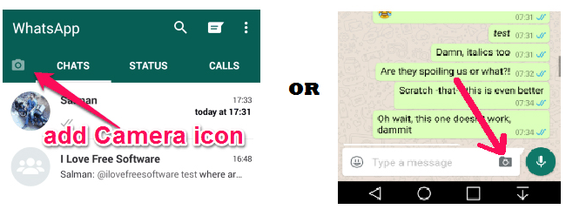
User Story: Example
As a <user role> I want to < goal > so that I can <reason of the goal>.
As a WhatsApp user, I want a camera icon in the chat write box to capture and send pictures so that I can click and share my pictures simultaneously with all my friends.
Notes:
Чаще всего встречается для джуна.
ОТ юзера,
Структура Юзер Стори
Description
Use cases
Tech details
Acceptance Criteria
Attachments ( designs, mockups, etc.)

Slide 11
User Story: Acceptance Criteria
Acceptance criteria is a set of accepted conditions or business rules which the functionality or feature should satisfy and meet, in order to be accepted.

Slide 12
Acceptance criteria
Acceptance criteria are a formalized list of requirements items that ensure that the task/enhancement specification completed and all test cases are taken into account. We put acceptance criteria specifying conditions under each task/ enhancement.
It’s natural that different people see the same problem from different angles. Clearly written criteria introduce a single solution to the functionality you intend to implement supporting task/ enhancement specification.

Slide 13
Acceptance criteria: What are Acceptance Criteria Used For?
To define boundaries. Acceptance criteria help development teams define the boundaries of tasks/ enhancements. In other words, acceptance criteria help you confirm when the application functions as desired, meaning that a user story is completed. To reach consensus. Having acceptance criteria synchronizes the development team with the client. The team knows exactly what conditions should be met, just as the client knows what to expect from the app.
To serve as a basis for tests. Last but not least, acceptance criteria are a cornerstone of positive and negative testing aimed at checking if a system works as expected.
To allow for accurate planning and estimation. Acceptance criteria scenarios allow for the correct division of tasks/ enhancements into tasks/ enhancements so they are correctly estimated and planned.

Slide 14
Acceptance Criteria Example
When I click on a picture, I should be able to add a caption to the image before sending it.
If there is some problem with starting my phone camera, an error message like ‘Camera could not be started’ should be shown accordingly.
…
Notes:
+
Functional and non-functional
Detailed
Cover important cases
Negative cases (error messages)
Testable

Slide 15
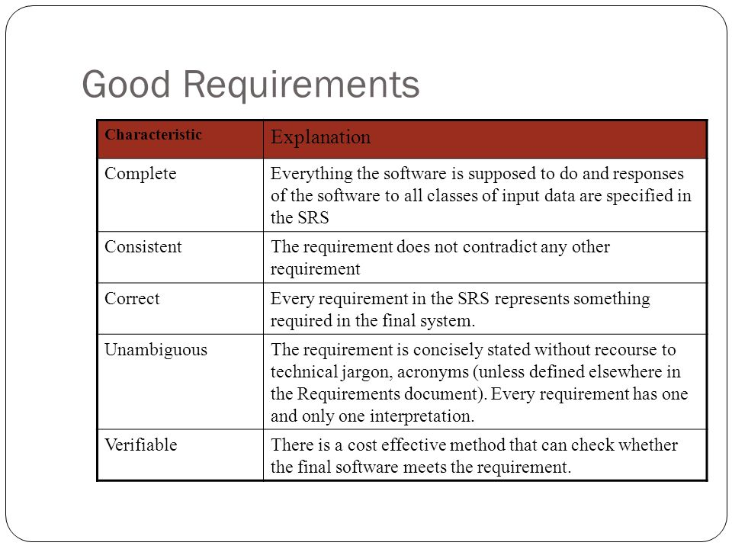
Notes:
Перерыв!2!

Slide 16
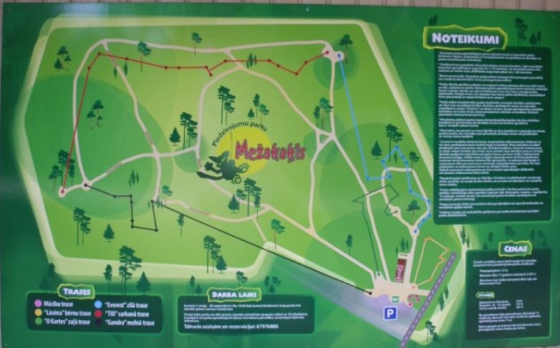
Requirements specification: Practice
Adventure park provides routes of different complexity levels for children and adults. To apply please consider below information.
Task: Find out a questions to the specification of Adventure park
Prices:
Kids who can use only yellow routes = 5.00 EUR
Kids who can use green routes = 8.00 EUR
Kids (up to 17 years old) = 12.00 EUR
Adults = 18.00 EUR
- Yellow route is allowed for beginners and kids from 110 cm height
- Green route is higher than yellow, more complex and allowed for kids from 140 cm height
- Blue route is higher than green and allowed for kids from 160 cm height
- Black route is more complex than previous ones and allowed for sports people
Notes:
Что можно уточнить:
17 лет включительно?
А какие трассы могут использовать 17-летние?
Взрослые – со скольки лет считается?
C такого-то роста - включая или нет?
А взрослым какую трассу можно?
Начинающий и ребёнок? А если взрослый начинающий или ребёнок выше ростом?
Вес человека важен?
Физическая подготовка?
Оплата наличными или картой?
Макcимальное кол-во людей одновременно на 1 трассе? Максимальное кол-во людей всего в парке одновременно?
Рост в обуви или без?
Состояние здоровья?
...

Slide 17
Agenda
Test design techniques. EP and BVA.
Test Design Techniques lvl2. State Transition and others.
Specification. What is it?
Specification Types. User Story. Acceptance Criteria.
Practice “Adventure Park”.
Project Documentation.
Agile Documentation
DOD
DOR
Grooming session. Goals. Estimation.

Slide 18
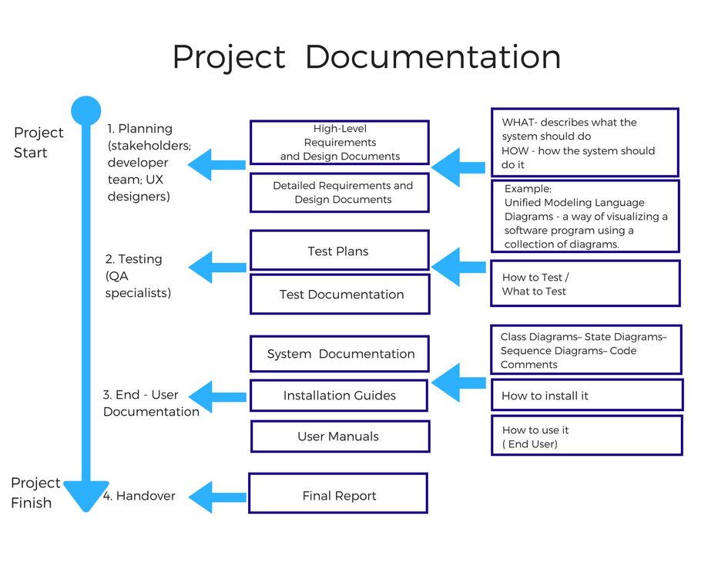

Slide 19

Agile Project usual documents list
Project Scope
Product Backlog Items
Coding policy or Coding guidelines
UX guideline
DoD
DoR
Templates: Bug, test case
RTM (traceability matrix)
Test report(s)

Slide 20
Definition of Ready
These considerations are often summarized as the "INVEST criteria", and they provide us with a useful Definition of Ready which can be applied to Task. By actively participating in Product Backlog refinement, a good Development Team will collaborate with the Product Owner in making sure that a standard such as this is observed.
I (Independent). The Task should be self-contained and it should be possible to bring it into progress without a dependency upon another Task or an external resource.
N (Negotiable). A good Task should leave room for discussion regarding its optimal implementation.
V (Valuable). The value a Task delivers to stakeholders should be clear.
E (Estimable). A Task must have a size relative to other Tasks.
S (Small). Tasks should be small enough to estimate with reasonable accuracy and to plan into a time-box such as a Sprint.
T (Testable). Each Task should have clear acceptance criteria which allow its satisfaction to be tested.

Slide 21
Definition of Done
For scrum teams, it’s really important to have a solid definition of what “done” means. They work in sprints and need some way of deciding whether a user story is actually finished. It’s no good ending a sprint with a user story that meets all its acceptance criteria, but had no code review, hasn’t been tested and isn’t deployable. Such a story is clearly not done. Scrum teams solve this by strictly defining “done”.
The definition of done (DoD) is when all conditions, or acceptance criteria, that a software product must satisfy are met and ready to be accepted by a user, customer, team, or consuming system. We must meet the definition of done to ensure quality. It lowers rework, by preventing user stories that don’t meet the definition from being promoted to higher level environments. It will prevent features that don’t meet the definition from being delivered to the customer or user.

Slide 22
Grooming session
Grooming sessions( Pre-review of the Feature Specifications.) This activity should introduce testing team at the very beginning of the feature implementation, allowing to perform documentation testing, improving documentation and feature with testers feedback.

Slide 23
Grooming session: Main goals.
Testing team on their side should concentrate on specification review from testing perspective to:
Gain clear understanding about the planned feature.
Ensure the feature is testable, all possible business cases are discussed and covered in documentation, possible impact/dependencies on other features/3rd parties are taken into account, negative cases like error handling was discussed, etc.
Ensure each involved person have same understanding of the feature and its purpose.
Which additional testing types should be included. (like Security testing, Performance testing, UI/UX testing, etc.)
Subjective feature estimation is provided in agreed way (if planned).

Slide 24
Grooming session: Estimation.
Estimate of story
T-shirts estimation
Human Hours estimation (Tasks or sub-tasks)
Story point estimation (effort, uncertainties, complexity)

Slide 25
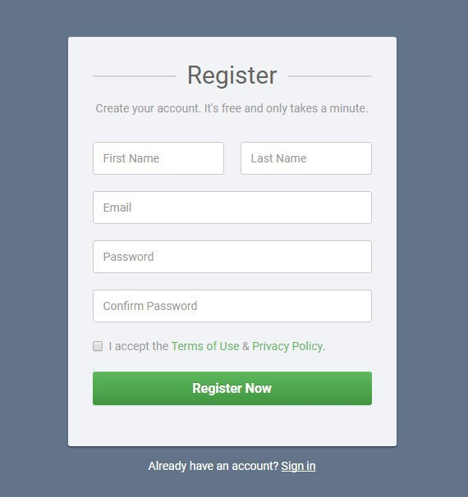
HomeWork 4 (“Real Story testing”)
Description:
As a User, I want to be able to Register into the system, using my user data. User data: Name/Surname, email and Password.
Upon adding correct data User should be registered.
Acceptance Criteria:
Fields “First Name” and “Surname” -
allowed: Latin characters
filed length 2-15
Special characters are not allowed
2. E-mail field
Mandatory to use @ symbol
No Spaces
3. Password Field –
Minimum 6 characters, maximum 20,
Allowed: Latin characters, numbers, special symbols,
Spaces are not allowed
HW Task:
Review and analyze the story description from the Testing perspective, using different test design techniques. Try to find out missed requirements, uncertainties, mistakes. Create a set of questions to solve them.
Additional task:
Create checklist to test the Form (~ 10 – 15 checks )
Notes:
Возможные вопросы:
Различия в наименованиях полей (last name)
Неописаны какие поля обязательны для регистрации
Нет требований к полю “Confirm Password”
Нет требований к чекбоксу
Нет требований к ссылке Terms
Нет описания валидаций, если юзер вводит неверные данные
Нет описания формата Имейла
Неясны границы полей Имя\Фамилия (неточное равенство)
Не указаны разрегенные символы для имейла
Не указана длина Имейл поля
Нет требований к SignIn
ДОП задание – «представьте что по требованиям разраб создает форму, какие места будут наиболее рискованными и могут содержать дефекты. Эти проверки и будут наиболее приоритетными»

